Slide 1

Building a portfolio website
Christian Dalton

Slide 2
What we will cover
Github
VS Code

Slide 3
Tech Requirements
Network
Satellite
Link

Slide 4

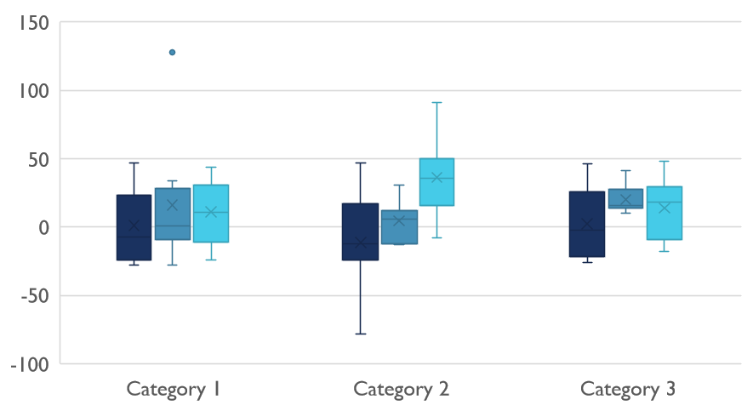
Competitive Landscape

Slide 5

Digital Communications
Cloud
Local
Hybrid

Slide 6

Thank You
someone@example.com

